Slide 1
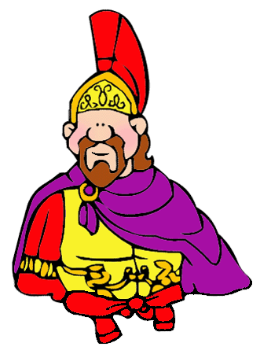
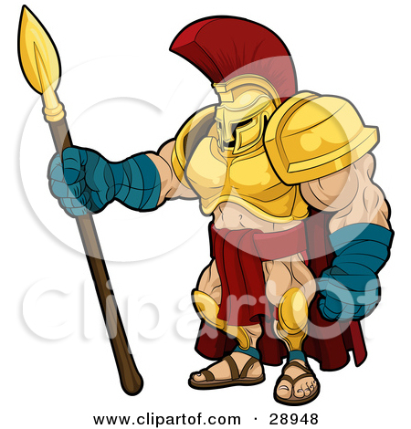
ROMANS
By : Aaliyah C and Harry F

Slide 2
CONTENTS PAGE
1 . Roman soldiers
2 . Roman myths
3 . Roman food and cooking
4 . Roman clothes
5 . Family life

Slide 3
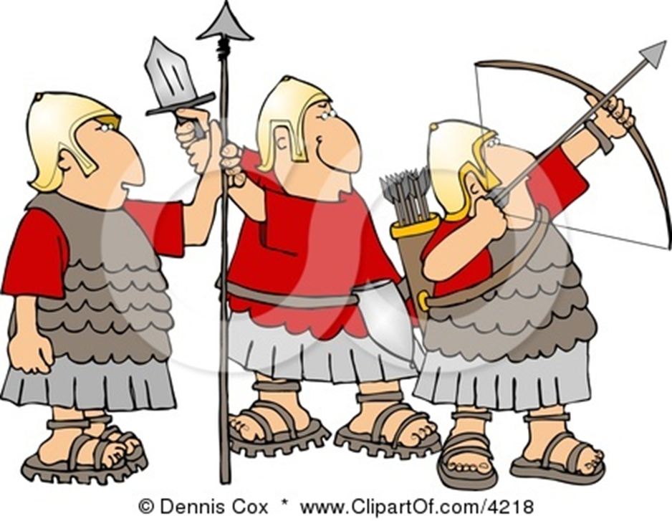
Roman soldiers
Who were the soldiers?
The soldiers in the Roman Legionary were all Roman citizens. They signed up to fight for 20 years. At the end of the 20 years they were generally awarded land and/or a large sum of money. This way the army was made up of trained and experienced soldiers. It also put land in the hands of loyal soldiers. There were also non-citizen soldiers called auxiliaries. They joined for 25 years and were awarded Roman citizenship at the end of the 25 years. Roman citizenship was a big deal and came with lots of privileges.
Contents

Slide 4
roman myths
The Romans believed in lots of gods. There were gods for just about everything. The Romans even took on many of the gods of the people they conquered. They especially liked the Greek gods. Many Romans had a shrine in their house to worship their personal household god. The Romans adopted much of Greek Mythology into their own. They took most all of the Greek gods, gave them Roman names, and then called them their own. Here are a few of major Roman gods that came from the Greeks:Jupiter - Came from the Greek god Zeus. Jupiter was the king of the gods and god of thunder and lighting. He was the Patron God of Rome.
Juno - Juno was the equivalent of the Greek goddess Hera. Juno was Jupiter's wife and queen of the gods. Juno was considered the protector of Rome.
Mars - Mars came from the Greek god Area. Mars was the god of war and Jupiter and Juno's son. contents

Slide 5
Roman food and cooking
People in Ancient Rome ate a wide variety of foods. What a person ate depended on both their wealth and where they lived in the Roman Empire. Food was imported from all around the empire to feed the large populations in the capital of Rome.
.
The Romans ate three meals during a typical day. The first meal (breakfast) was called the "lentaculum." It was usually eaten around sunrise and consisted of bread and maybe some fruit. The next meal (lunch) was called the "prandium". The prandium was a very small meal eaten around 11 AM. The main meal of the day was the "cena." It was eaten in the afternoon .
contents

Slide 6
Roman Clothing
Most of the clothing worn in Ancient Rome was made of wool. Wool was made throughout Italy and much of the Roman Empire both in the home and commercially. Sometimes clothes were made from rare materials such as linen from Egypt, cotton from India, and silk from ChinaMen generally wore white or off-white colored clothing. There were certain colors or markings that showed the status of a man. Women wore white clothing until they were married. Once married, they wore clothing in a variety of colors. contents

Slide 7
Family life
Family was an important part of Ancient Roman culture and society. Much of Roman law was written around protecting the basic structure of the family. The family you belonged to had a lot to do with your place in Roman society and whether you were considered a patrician or a plebeian. The legal head of the family was the father or "paterfamilias." He was the oldest living male in the household. The paterfamilias had legal authority over the other members of the household. He decided who his children would marry and issued punishment for any family member that disobeyed him. In early Rome, he could even have family members put to death, but this rarely actually happened. cotentsn

